Slide 1

VEHICLE ASSISTANCE NETWORK
Name: Pawan Kumar K.P
USN: 4SO23MC068
Under The Guidance of:
Internal Guide:
Ms. Sumangala N
Asst Professor
Department of Computer Applications
External Guide:
Mr. Harish Neermarga
Managing Director
Accolade Tech Solutions Private Limited

Slide 2
Company Profile
Name: Accolade Tech Solutions Pvt Ltd, Mangaluru
Expertise: Mobile & Web Development, Smart TV Apps, Digital Marketing, AI solutions
Technologies: Flutter, Python, React JS, Node JS, PHP, AWS, GCP
Experience: 12+ years; developed OTT, e-commerce, niche apps
Focus: Future-ready, scalable, user-friendly solutions

Slide 3
Introduction
Internship at Accolade Tech Solutions Pvt Ltd
Role: Frontend Web Developer Intern
Duration: May-05-2025 to July-25-2025
Objective: Apply classroom knowledge in real-world projects
Main project: Vehicle Assistance Network

Slide 4
Literature Review
Studied existing vehicle service systems using ReactJS & MUI
Reviewed case studies for UI/UX best practices and issues
Identified challenges: performance in dynamic displays, order tracking, real-time inventory
Researched solutions for API integration, responsive design, and state management

Slide 5
Skills Gained
React JS: Component-based UI development, JSX, state management
Material-UI: Google’s Material Design components for consistent UI
JavaScript: Event handling, DOM manipulation, ES6+ features
CSS & Bootstrap: Responsive, mobile-first layouts
Public APIs: Data fetching with Axios/Fetch API
Node.js: Backend concepts & API integration

Slide 6
Application Of Skills
Built static pages with HTML/CSS
Enhanced interactivity with JavaScript
Managed state with useState & useEffect
Styled UI with Material-UI components and themes
Integrated public APIs for data fetching
Implemented responsive designs
Developed frontend modules (Admin, User, Employee)
Implemented routing with React Router
Connected frontend with MySQL backend via APIs

Slide 7
Position in the Organization
Designation: Intern – Frontend Developer
Worked under senior developer guidance
Collaborated in a team environment
Directly contributed to project deliverables

Slide 8
Software Requirements Specification
Purpose, Audience, Scope
Purpose: Digitalize vehicle service management
Audience: Admins, Employees, Customers
Scope: Service requests, job cards, billing, feedback, reports
Functional & Non-Functional Requirements
Functional: Admin/User/Employee modules
Non-functional: Performance, security, maintainability, portability

Slide 9
UI/UX Design
Material-UI for consistency
Responsive layouts
Clear navigation with React Router
Intuitive forms and tables

Slide 10
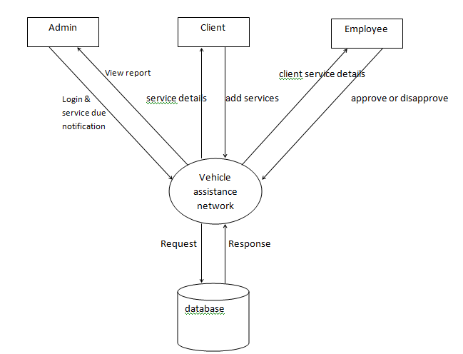
UML Diagrams
Context Flow Diagram

Slide 11
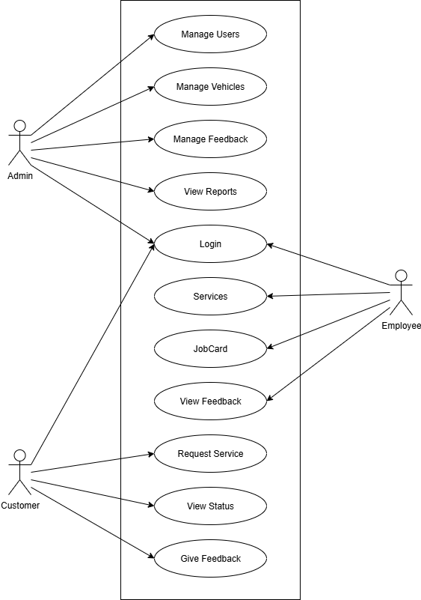
UML Diagrams
Use Case Diagram

Slide 12
Implementation
Frontend: React JS, Material-UI
Backend: Node.js (Express)
Database: MySQL
APIs tested with Postman
State managed with hooks
Modular, reusable components

Slide 13
Tools and Technologies
Languages: JavaScript, SQL
Frameworks: React JS, Material-UI
Tools: VS Code, MySQL Workbench, Postman
Platforms: Node.js, XAMPP

Slide 14
Modules
Admin Modules – Dashboard, Manage Users, Vehicles, Job Cards, Reports, Feedback
User/Employee Modules – Request Service, View Status, Feedback, Update Job Cards

Slide 15
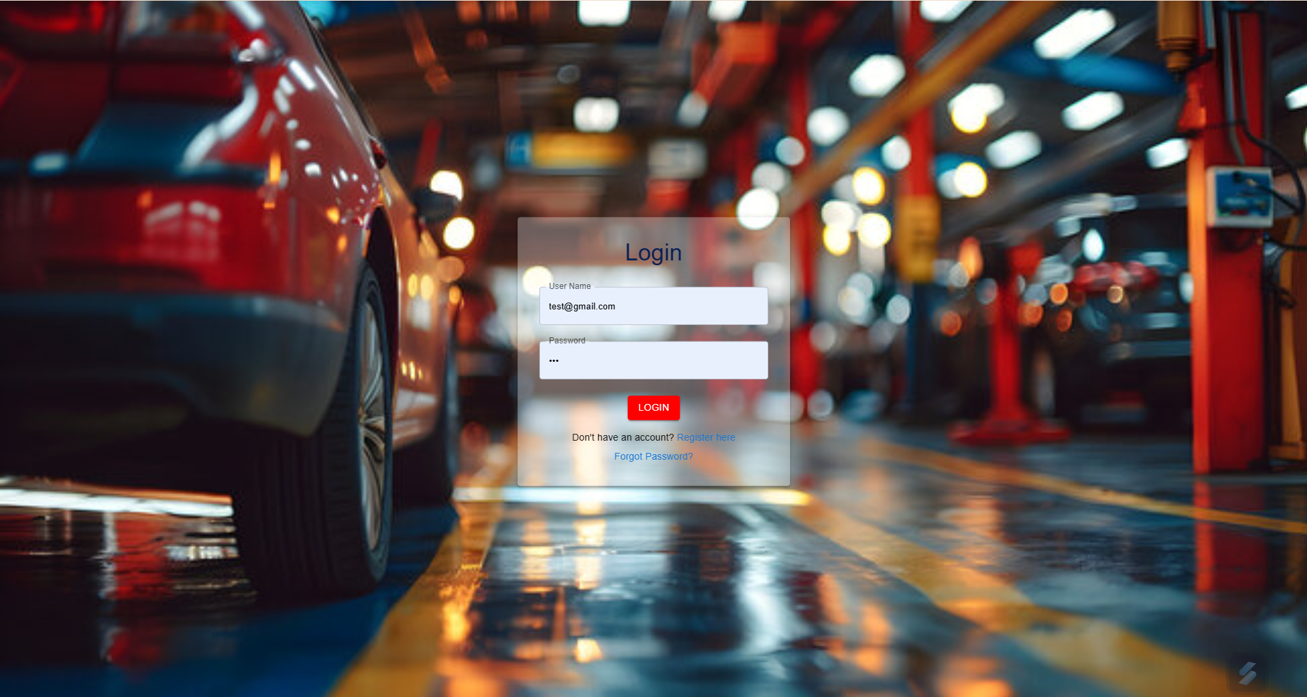
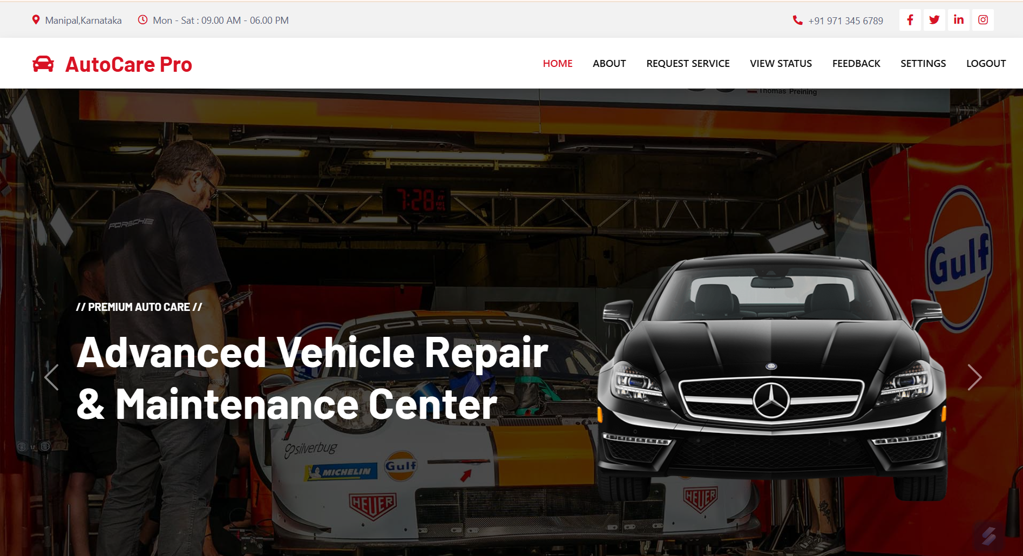
Screenshots
Login Page
Customer Home Page

Slide 16
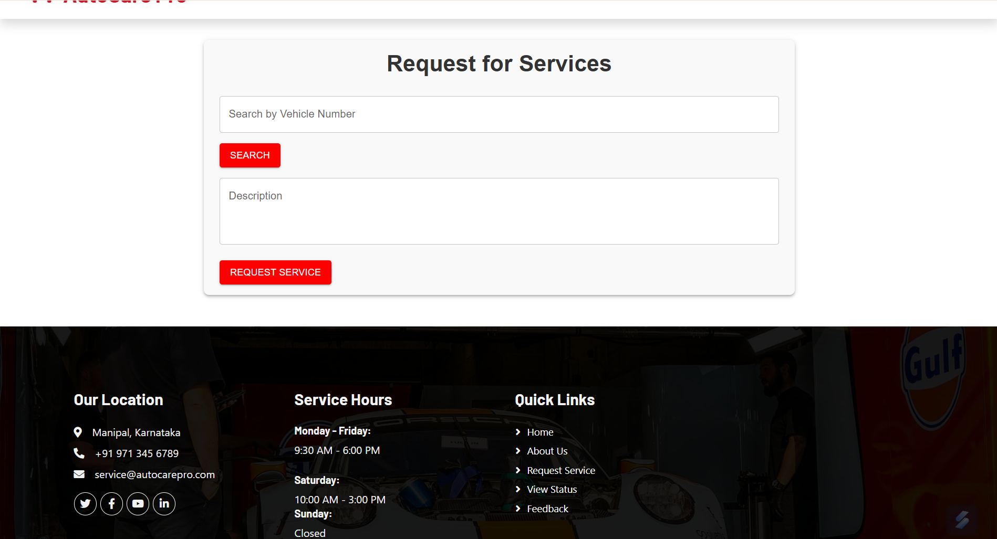
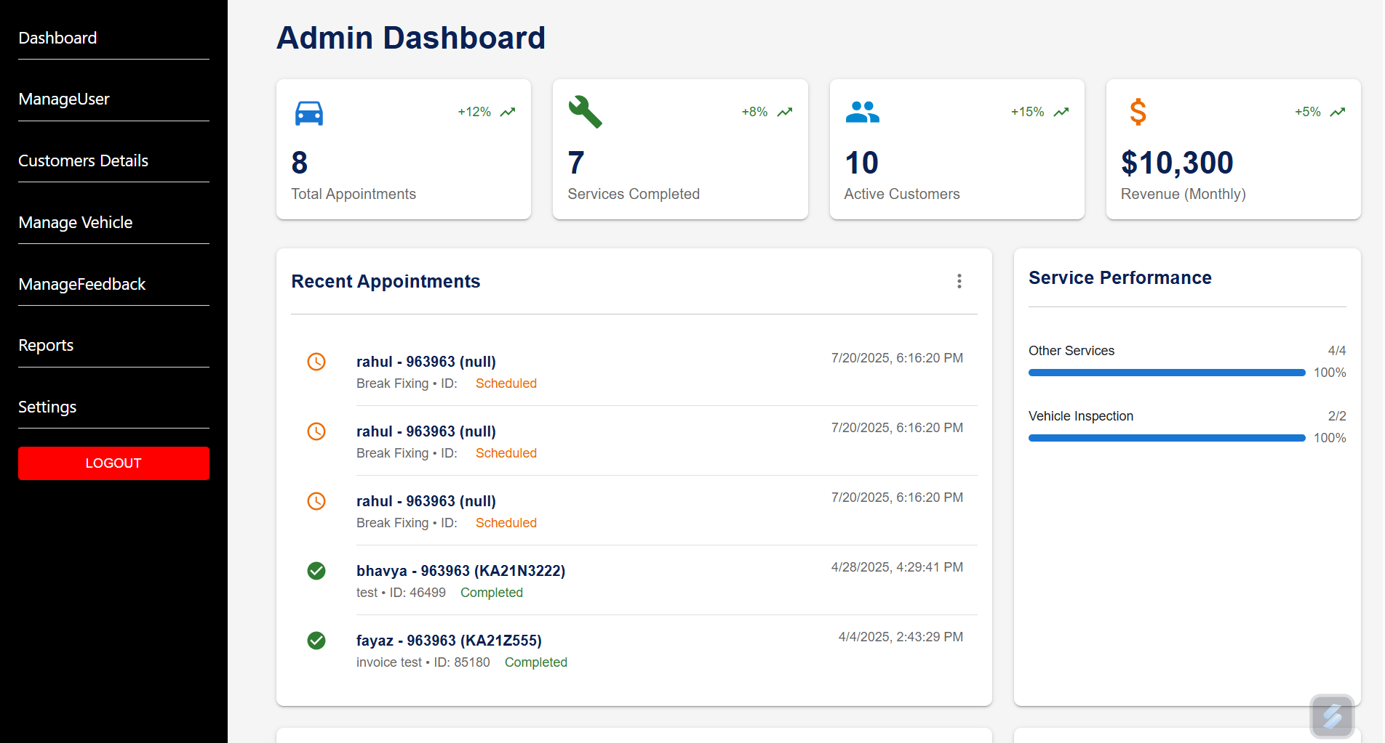
Screenshots
Service Request
Admin Dashboard

Slide 17
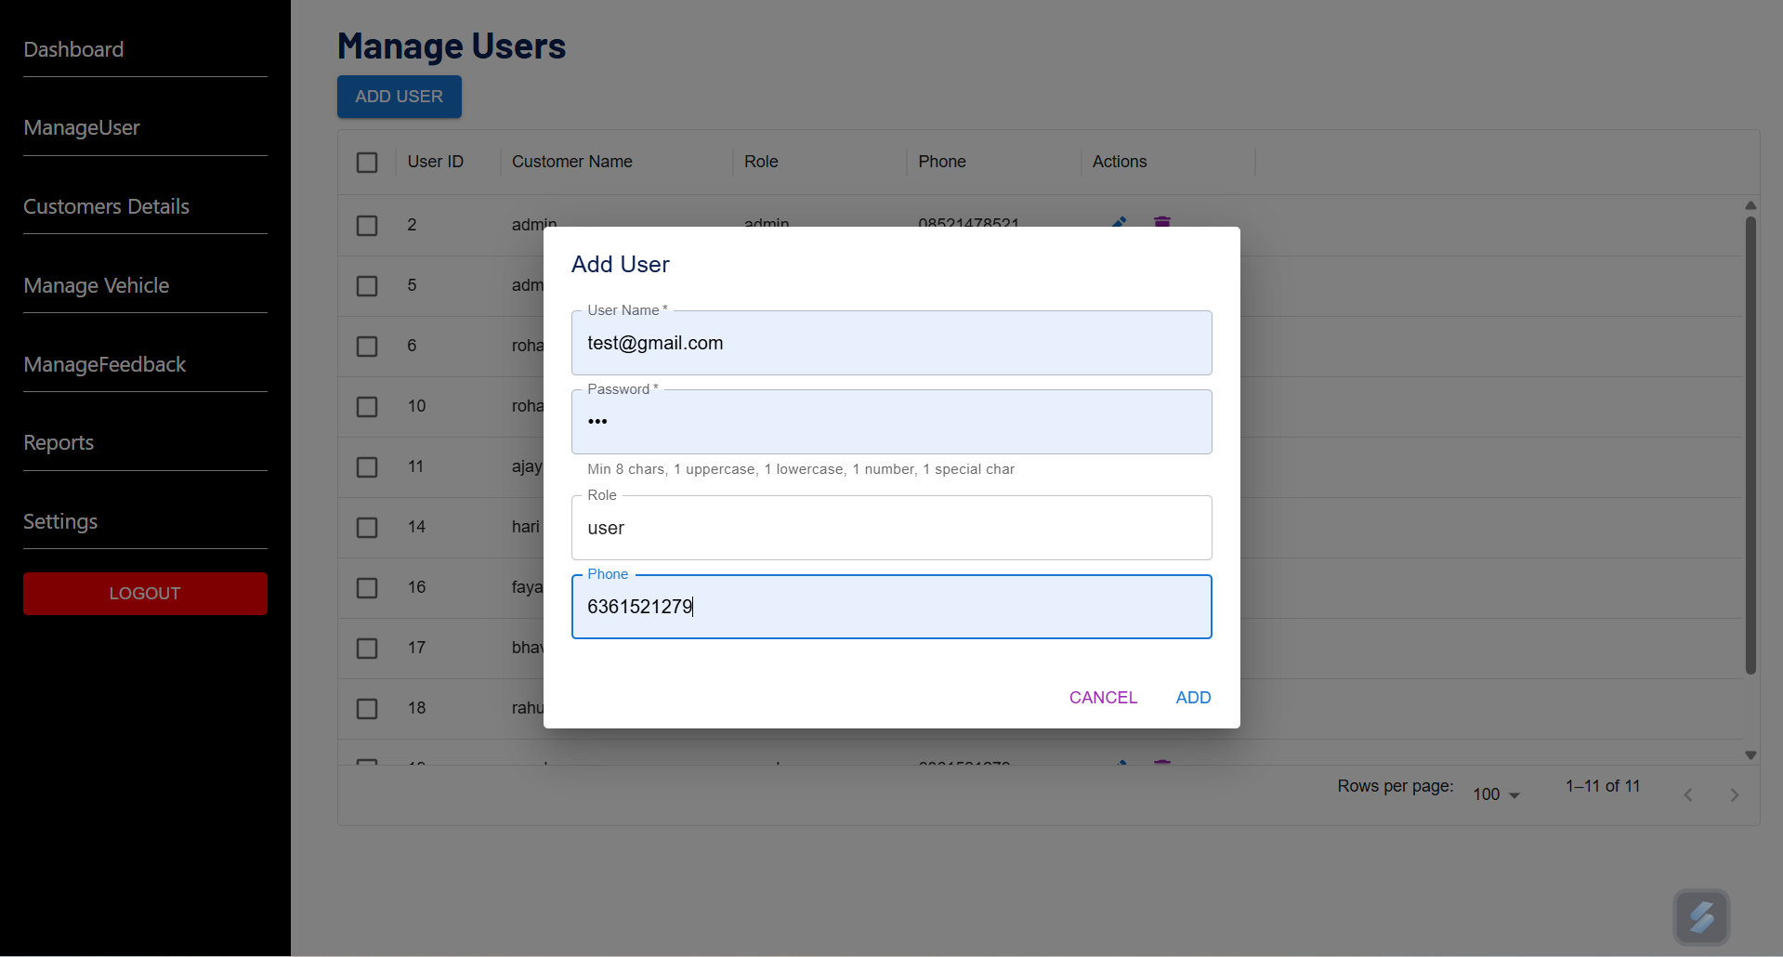
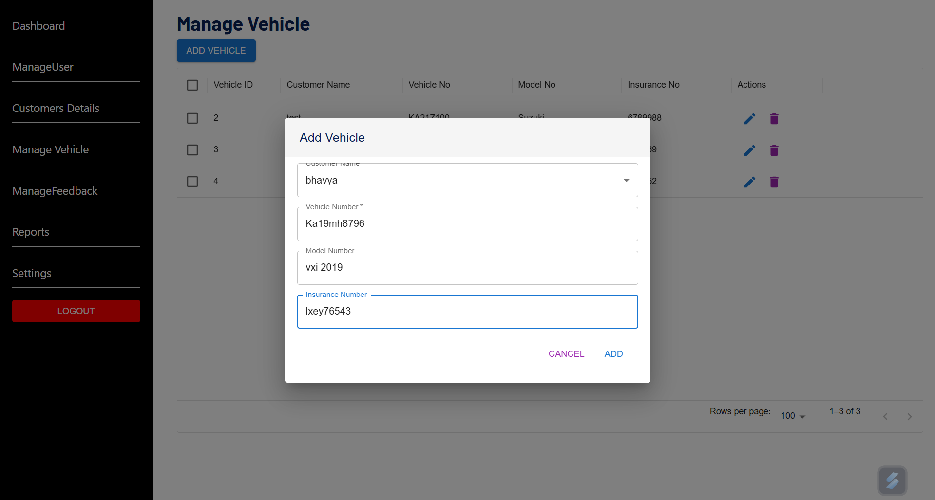
Screenshots
Manage Users
Manage Vehicles

Slide 18
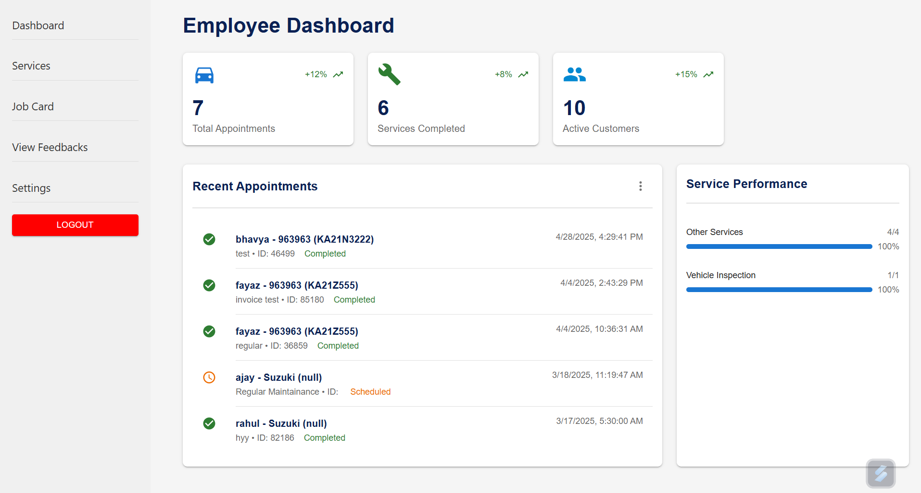
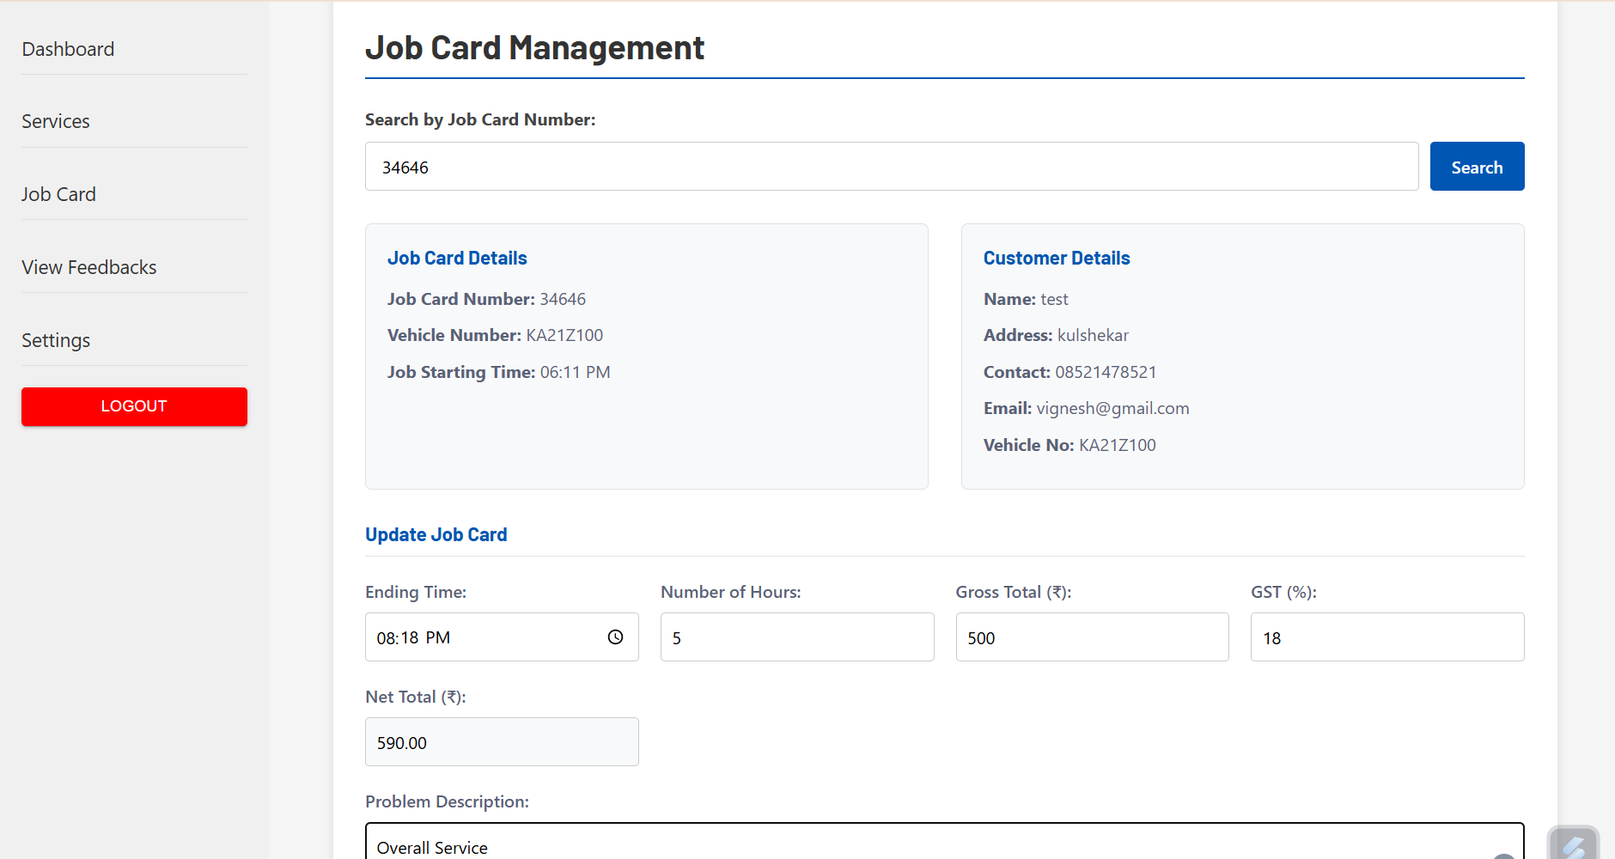
Screenshots
Employee Dashboard
Job Card Details

Slide 19
Challenges Faced
Adapting to new frameworks (React, MUI)
CORS & authentication issues
Ensuring cross-browser compatibility
Performance optimization

Slide 20
Conclusion
Gained real-world experience in web app development
Strengthened frontend skills with React JS, MUI
Learned API integration and database interaction
Improved teamwork and problem-solving abilities

Slide 21
References
ReactJS Documentation – https://react.dev/
Material-UI – https://mui.com/
W3Schools – https://www.w3schools.com/
Node.js – https://nodejs.org/
APIs: https://fakestoreapi.com/, https://dummyjson.com/

Slide 22
Thank You

